Slide 1
WaveNet
Pattern Recognition & Machine Learning Laboratory
Ji-Hoon Park
Aug 11, 2021

Slide 2
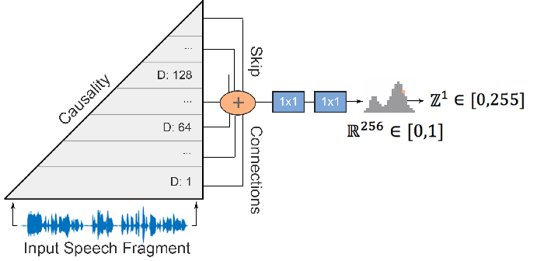
WaveNet: A Generative Model for Raw Audio [A. Oord et al., 2016] (1/5)
Goal
Generating wideband raw speech signals with subjective naturalness by developing new architecture
Motivation
Unnaturalness of the existing speech generation model
Contribution
Applying PixelCNN[A. Oord et al., 2016] to speech generation model to get more natural sound
Introducing dilated causal convolutions to exhibit very large receptive fields in order to deal with long-range temporal dependencies needed for raw audio generation
WaveNet Architecture
A. Oord et al., “WaveNet: A generative model for raw audio," Arxiv, 2016.
A. Oord et al., “Pixel Recurrent Neural Networks," PMLR, 2016.

Slide 3
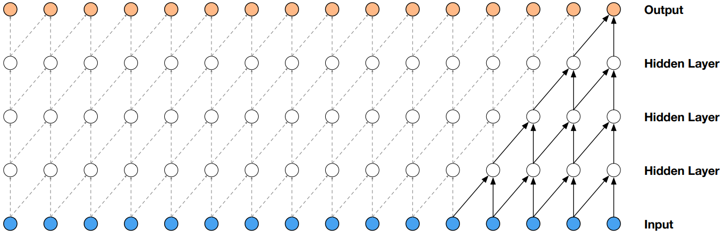
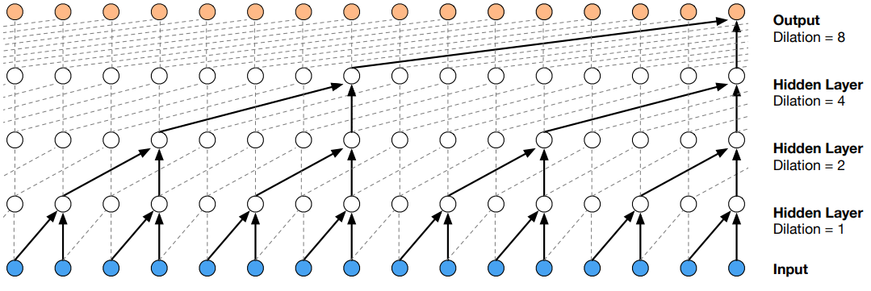
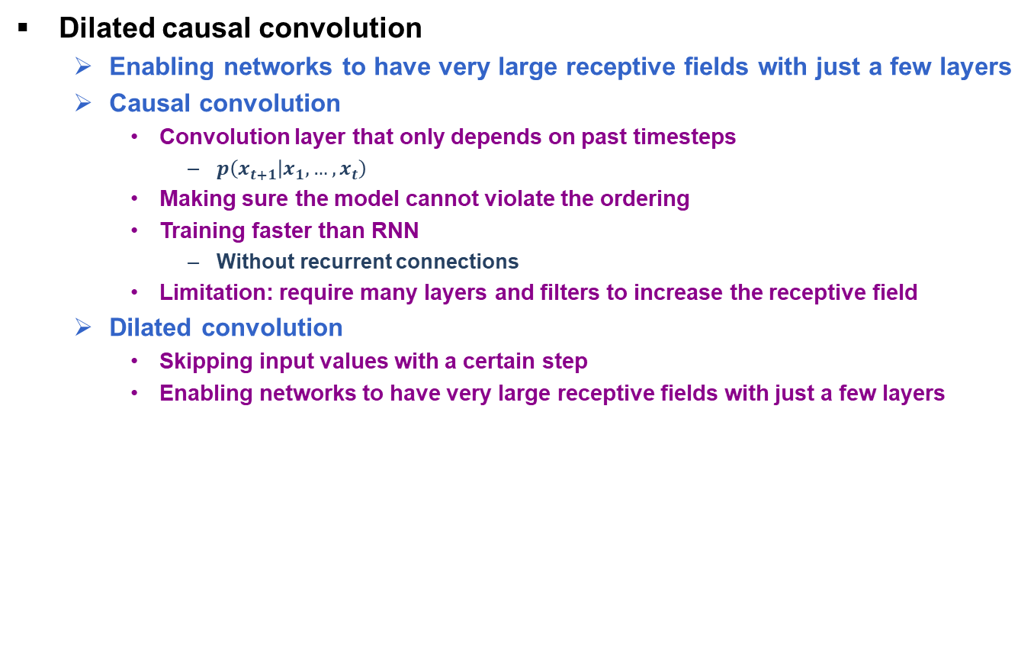
WaveNet: A Generative Model for Raw Audio [A. Oord et al., 2016] (2/5)
Dilated causal convolution
Enabling networks to have very large receptive fields with just a few layers
Causal convolution
Convolution layer that only depends on past timesteps
$p\left(x_{t+1} | x_{1}, …,x_{t}\right)$
Making sure the model cannot violate the ordering
Training faster than RNN
Without recurrent connections
Limitation: require many layers and filters to increase the receptive field
Dilated convolution
Skipping input values with a certain step
Enabling networks to have very large receptive fields with just a few layers
Causal convolution layers
Dilated causal convolution layers
A. Oord et al., “WaveNet: A generative model for raw audio," Arxiv, 2016.

Slide 4
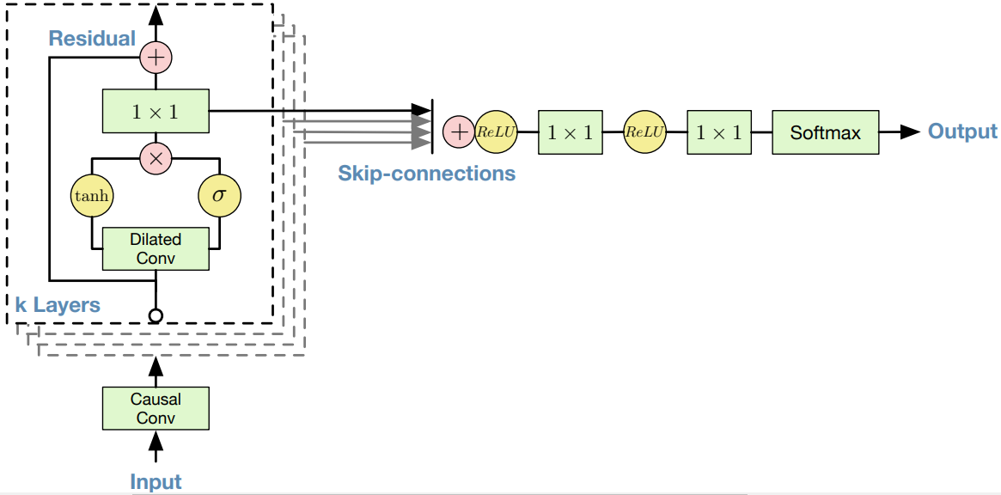
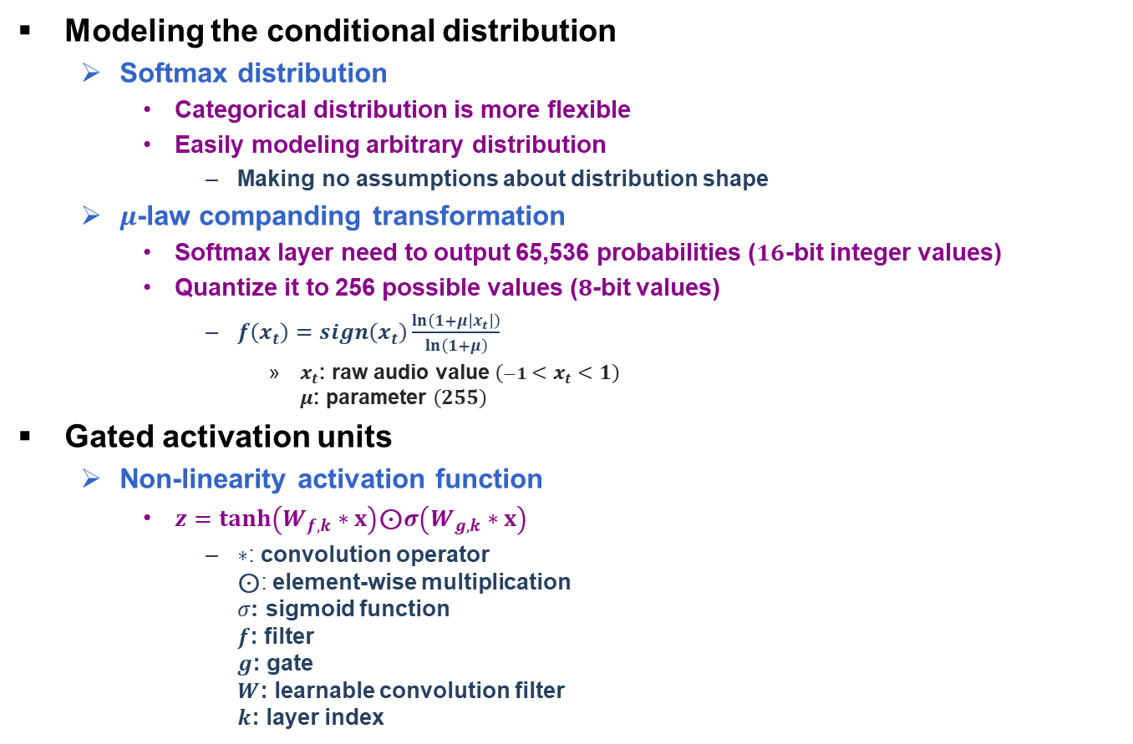
WaveNet: A Generative Model for Raw Audio [A. Oord et al., 2016] (3/5)
Modeling the conditional distribution
Softmax distribution
Categorical distribution is more flexible
Easily modeling arbitrary distribution
Making no assumptions about distribution shape
$μ$-law companding transformation
Softmax layer need to output 65,536 probabilities ($16$-bit integer values)
Quantize it to 256 possible values ($8$-bit values)
$f\left(x_{t}\right)=sign\left(x_{t}\right)\frac{\ln\left(1+μ\left|x_{t}\right|\right)}{\ln\left(1+μ\right)}$
$x_{t}$: raw audio value $\left(−1<x_{t}<1\right)$ $μ$: parameter $\left(255\right)$
Gated activation units
Non-linearity activation function
$z=\tanh\left(W_{f,k}∗x\right)$⊙$σ\left(W_{g,k}∗x\right)$
$∗$: convolution operator ⊙: element-wise multiplication $σ$: sigmoid function $f$: filter $g$: gate $W$: learnable convolution filter $k$: layer index
input
WaveNet Architecture
A. Oord et al., “WaveNet: A generative model for raw audio," Arxiv, 2016.

Slide 5
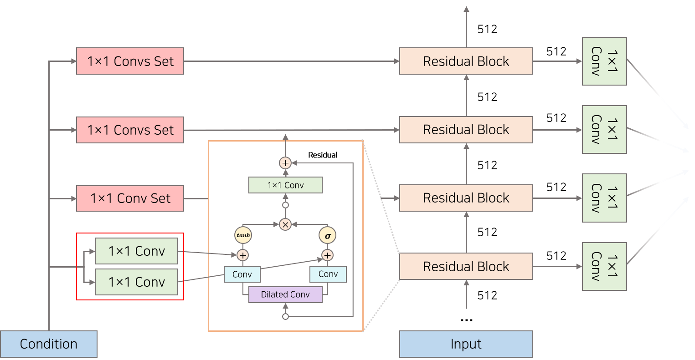
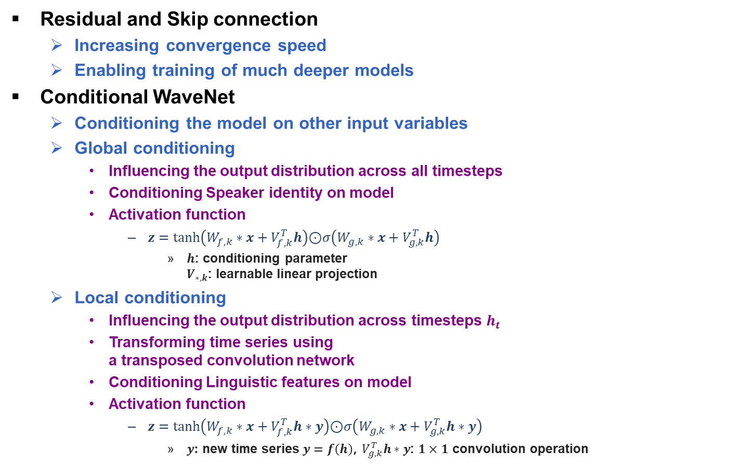
WaveNet: A Generative Model for Raw Audio [A. Oord et al., 2016] (4/5)
Residual and Skip connection
Increasing convergence speed
Enabling training of much deeper models
Conditional WaveNet
Conditioning the model on other input variables
Global conditioning
Influencing the output distribution across all timesteps
Conditioning Speaker identity on model
Activation function
$z=\tanh\left(W_{f,k}∗x+V_{f,k}^{T}h\right)$⊙$σ\left(W_{g,k}∗x+V_{g,k}^{T}h\right)$
$h$: conditioning parameter $V_{∗, k}$: learnable linear projection
Local conditioning
Influencing the output distribution across timesteps $h_{t}$
Transforming time series using a transposed convolution network
Conditioning Linguistic features on model
Activation function
$z=\tanh\left(W_{f,k}∗x+V_{f,k}^{T}h∗y\right)$⊙$σ\left(W_{g,k}∗x+V_{g,k}^{T}h∗y\right)$
$y$: new time series $y=f\left(h\right)$, $V_{g,k}^{T}h∗y$: $1×1$ convolution operation
input
WaveNet Architecture
Conditional WaveNet Architecture
A. Oord et al., “WaveNet: A generative model for raw audio," Arxiv, 2016.

Slide 6
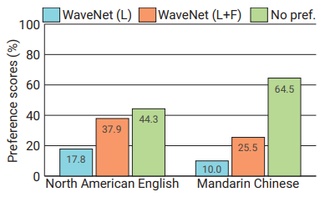
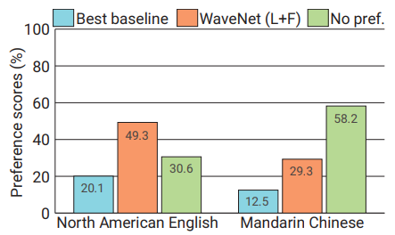
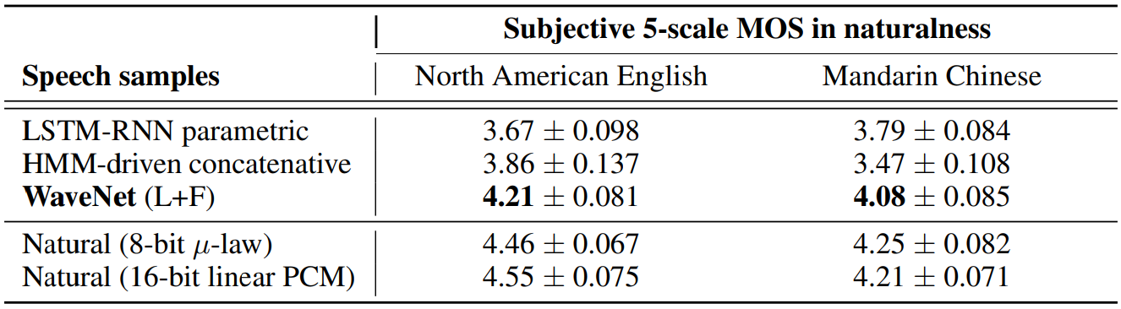
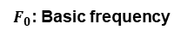
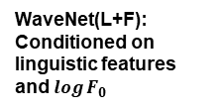
WaveNet: A Generative Model for Raw Audio [A. Oord et al., 2016] (5/5)
Experiments
Multi-speaker speech generation
Conditioning model on a one-hot encoding of a speaker
Dataset
CSTR Voice Cloning Toolkit (VCTK)
Text to Speech (TTS)
Comparing WaveNet to HMM (Hidden Marcov Model) and LSTM-RNN (Long Short-Term Memory Recurrent Neural Network)
Datasets
Google’s North America English and Mandarin Chinese dataset
Tests
Subjective paired comparison tests and Mean Opinion Score(MOS) tests
Music and Speech recognition
Datasets
MagnaTagATune dataset, YouTube piano dataset, and TIMIT dataset
WaveNet(L+F): Conditioned on linguistic features and $\log{F_{0}}$
Mean Opinion Score test results
$F_{0}$: Basic frequency
Subjective paired comparison test results
A. Oord et al., “WaveNet: A generative model for raw audio," Arxiv, 2016.

